Slide 1
Progress Report: Learning dynamics in a cellular automata model of classroom interaction
SY, clarence Ioakim t. (BS 4)
Adviser: Johnrob y. Bantang
Complexity science group

Slide 2
Motivation:
Model peer-to-peer learning inside the classroom
Investigate how the following affects the learning dynamics in a classroom:
Student aptitude level
Seating arrangement (with respect to student aptitude)
Aptitude homogeneity

Slide 3
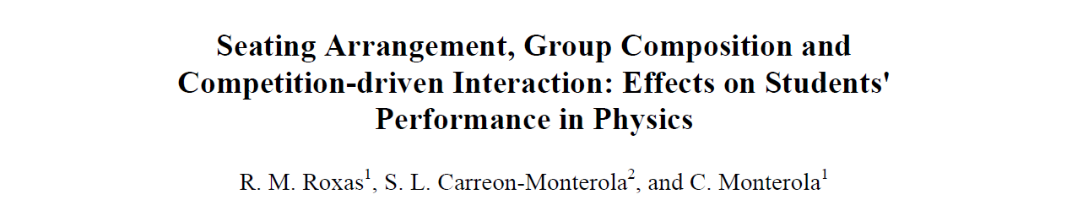
Previous study:
Uses a neural network to predict the outcome of the classroom based on the initial seating arrangement and aptitude levels of the students
Findings:
Homogeneity (locally and globally) benefits learning of the classroom
Learning is not solely dependent on how high the aptitude level of the seatmates

Slide 4
System Observables:
Learning rate (overall and individual)
How does the number of learned students (binary states) or the class average (continuous states) evolve over time?
Class’s dependence on the initial conditions of the system
How does the position of learned/high scoring students affect the learning rate of the class?
Neighborhood combination based on the aptitude of the students in the neighborhood
How does the spatial aptitude homogeneity affect the learning rate of the class?
How does the social aspect affect the classroom (Watts–Strogatz model) dynamics

Slide 5
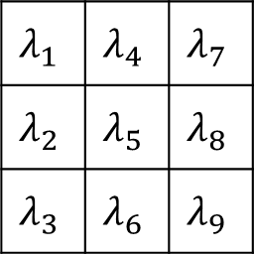
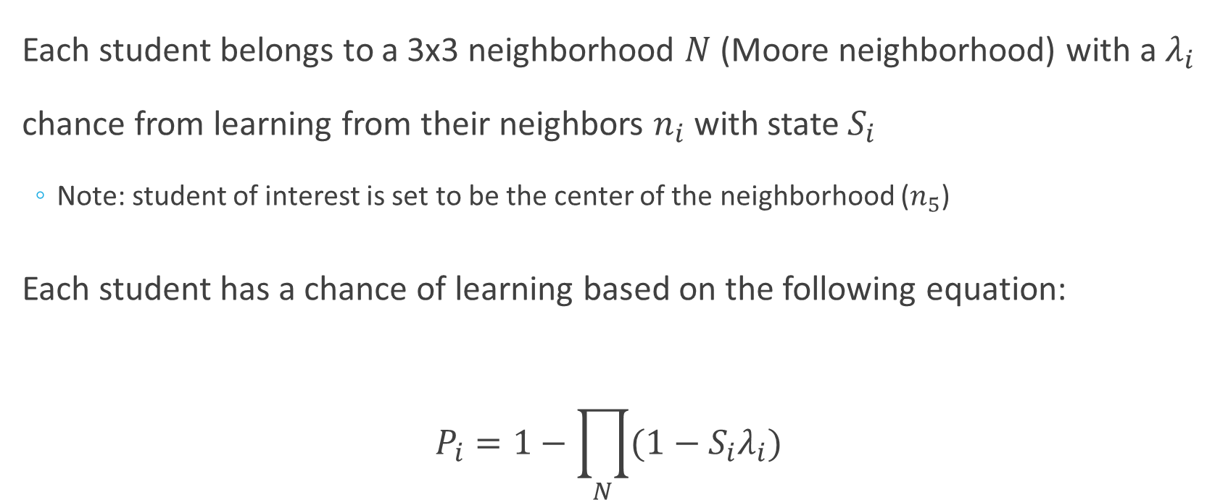
2D Binary Probabilistic Cellular Automata Model
Each student belongs to a 3x3 neighborhood $N$ (Moore neighborhood) with a $λ_{i}$ chance from learning from their neighbors $n_{i}$ with state $S_{i}$
Note: student of interest is set to be the center of the neighborhood ($n_{5}$)
Each student has a chance of learning based on the following equation:
$$P_{i}=1−\prod_{N}{(1−S_{i}λ_{i})}$$
$$λ_{1}$$ | $$λ_{4}$$ | $$λ_{7}$$
$$λ_{2}$$ | $$λ_{5}$$ | $$λ_{8}$$
$$λ_{3}$$ | $$λ_{6}$$ | $$λ_{9}$$

Slide 6
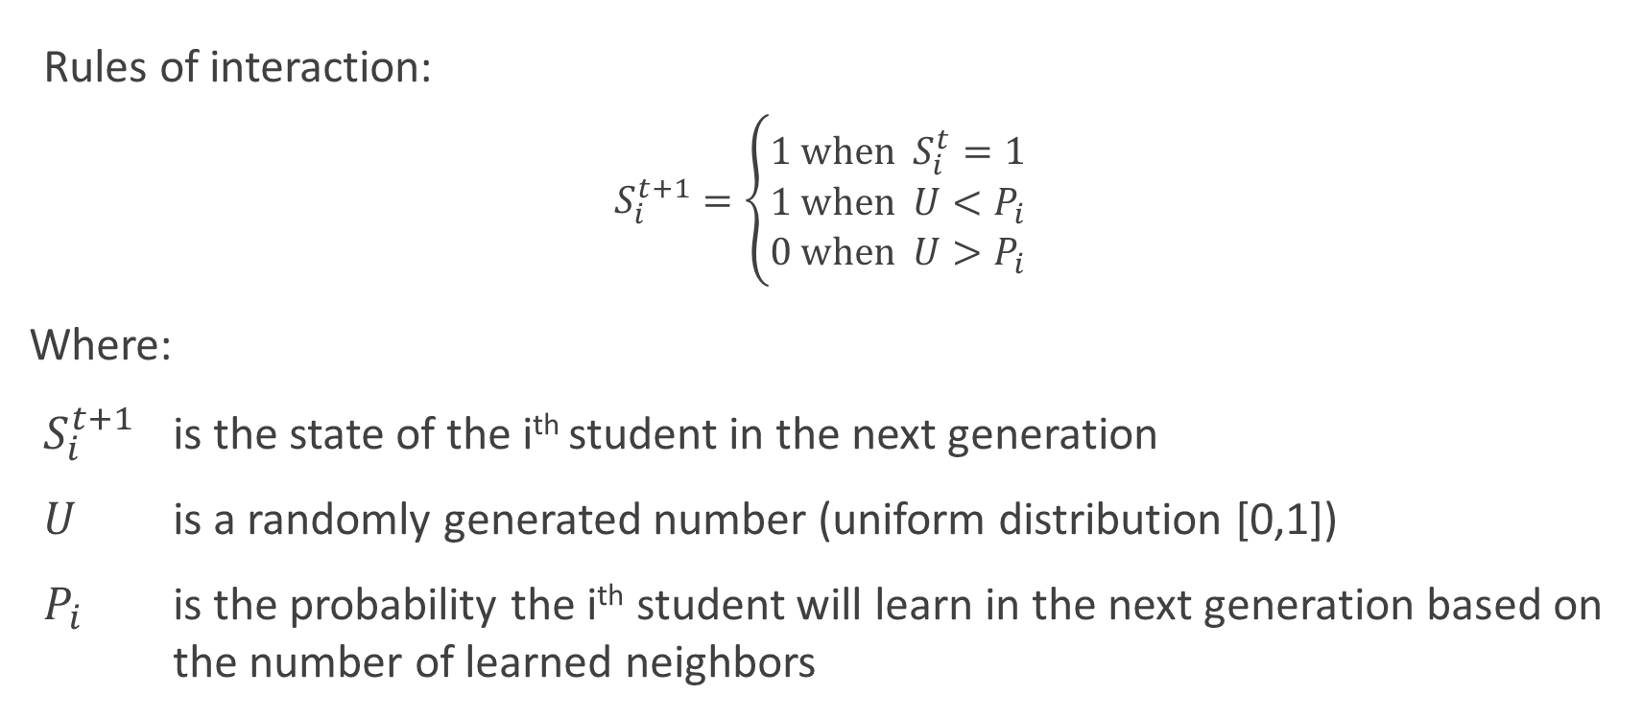
2D Binary Probabilistic Cellular Automata Model
Rules of interaction:
$$S_{i}^{t+1}=\left\{\begin{aligned}1 \text{when} S_{i}^{t}=1 \\ 1 \text{when} U<P_{i} \\ 0 \text{when} U>P_{i}\end{aligned}\right.$$
Where:
$S_{i}^{t+1}$ is the state of the i^{th} student in the next generation
$U$ is a randomly generated number (uniform distribution [0,1])
$P_{i}$ is the probability the i^{th} student will learn in the next generation based on the number of learned neighbors

Slide 7
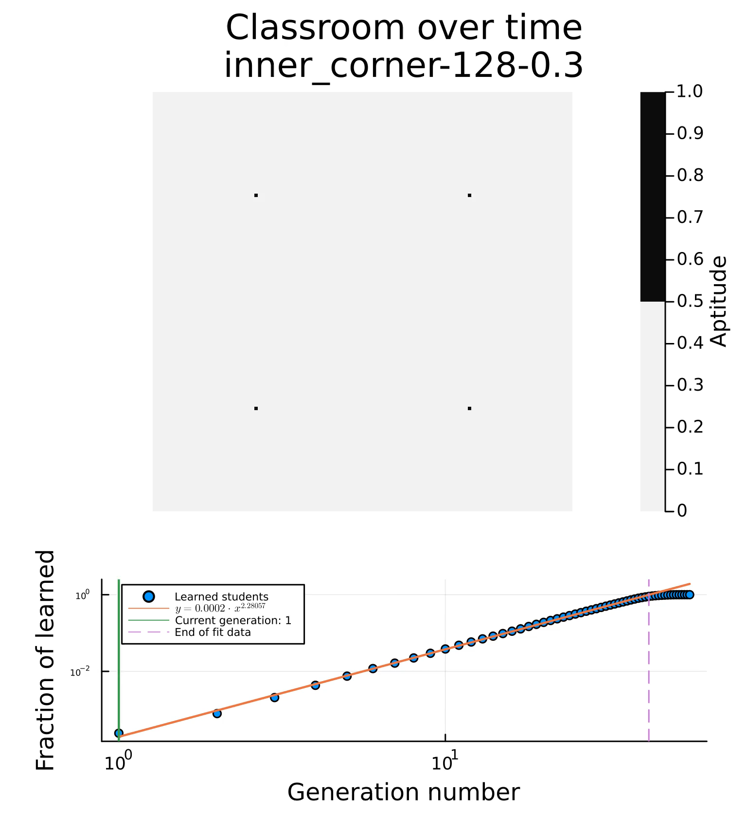
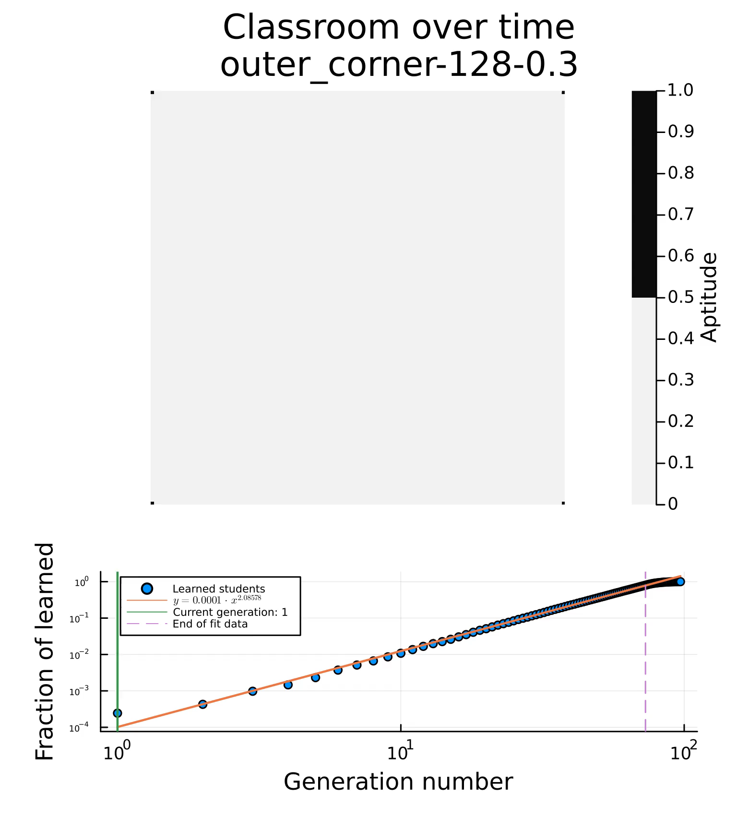
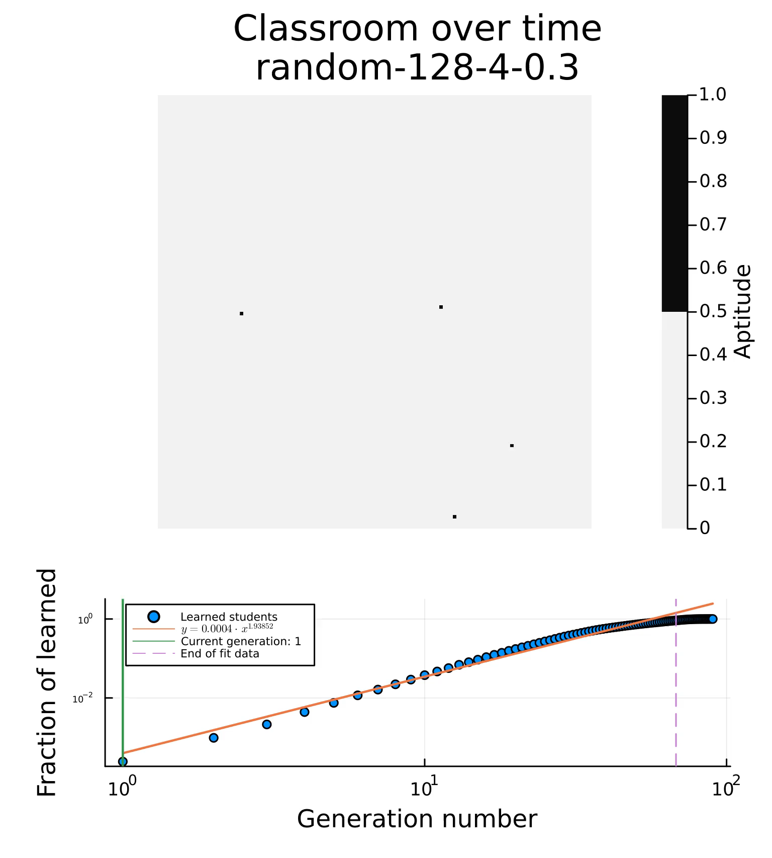
2D Binary Probabilistic Cellular Automata Model

Slide 8
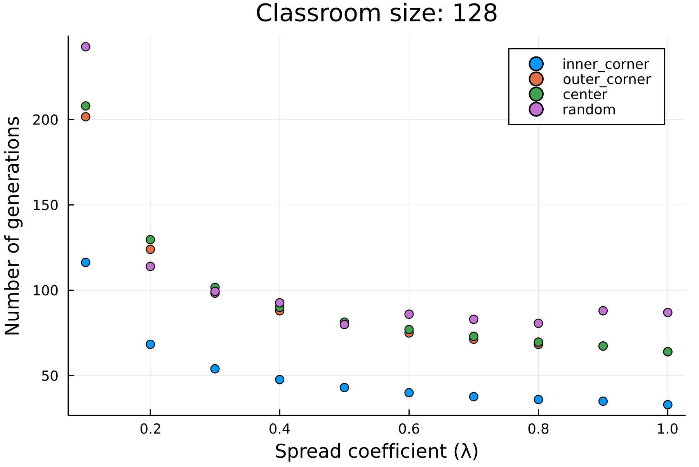
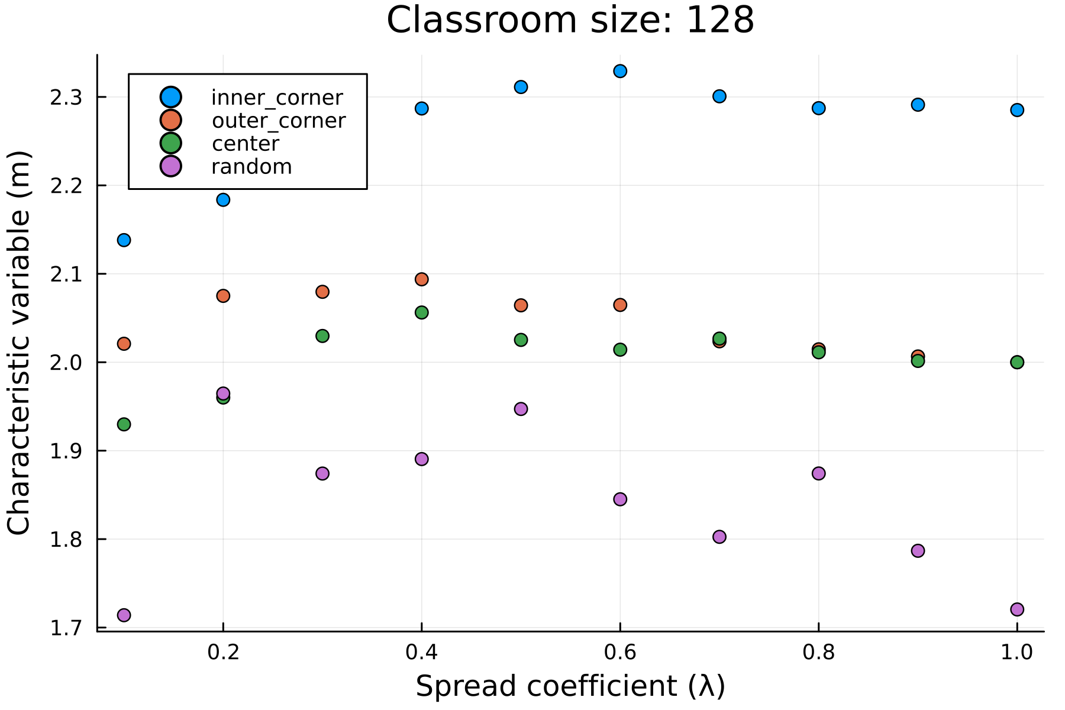

2D Binary Probabilistic Cellular Automata Model
Plots for:
Spread coefficient ($λ$) vs Characteristic variable (m)
Spread coefficient ($λ$) vs time to learn (n)

Slide 9
To do:
Introduce orientation bias in the system (anisotropic system)
Introduce inhomogeneous individual learning rate
Model the benefit of local/neighborhood homogeneity
Introduce memory or unlearning to the system
Adjust model to accommodate continuous student states
Fit model parameters to existing data

